Slide 1
Lab 1
Basic Network Setup
& Connectivity
CSIT491 - Network and Cybersecurity Lab
Anthony Castellanos • Imran Ahmed • Murtaza Syed
Nicolas Hoyos • Shaied Uddin

Slide 2
Lab Objectives
1
Identify and label each device in the network diagram
2
Assign a static IP address to PC0 and configure DHCP on the router for PC1 and PC2
3
Use the ping command to verify connectivity between all devices
4
Use ipconfig to confirm network settings on each PC

Slide 3
Equipment & Tools
Router
Switch
1x Cisco 2911 (GigabitEthernet Interface)
1x Cisco 2960-24TT (24-port)
End Devices
Software
3x PCs — 1 static IP, 2 DHCP
Cisco Packet Tracer
Network: 192.168.1.0 / 24 Gateway: 192.168.1.1 PC0: 192.168.1.50 (Static) PC1: 192.168.1.11 (DHCP) PC2: 192.168.1.12 (DHCP)

Slide 4
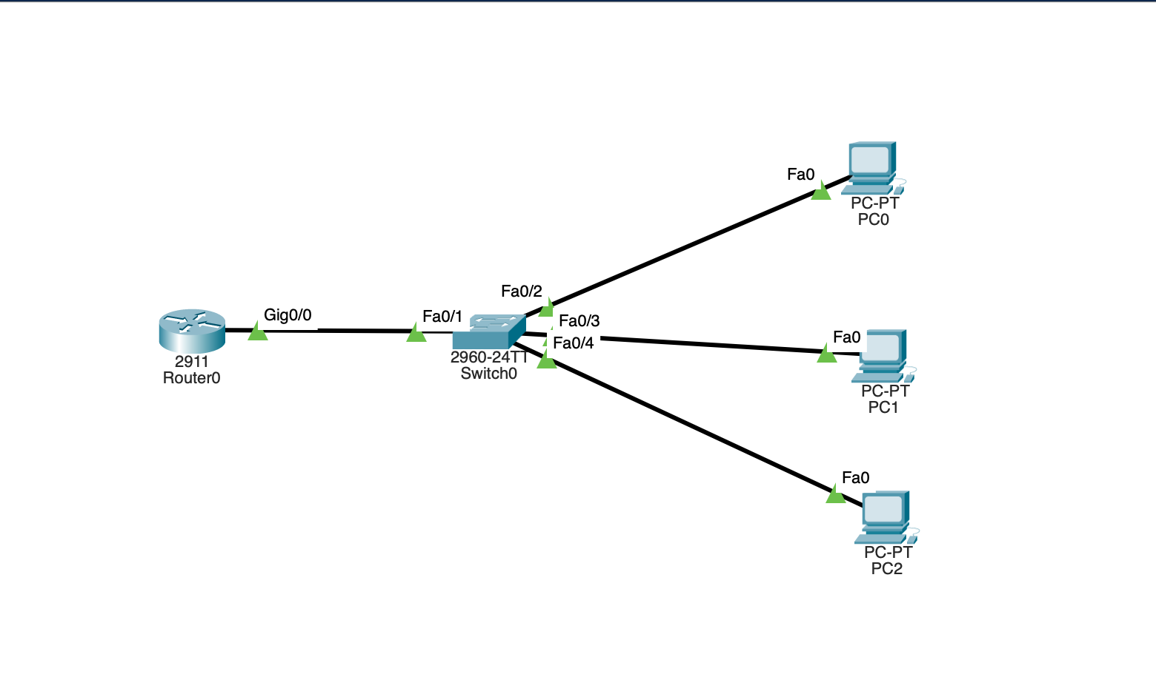
Network Topology
[ Insert Screenshot ]
Packet Tracer Network Topology Screenshot
Router0 (Gi0/0): 192.168.1.1 | PC0: 192.168.1.50 (Static) — Fa0/2 | PC1: 192.168.1.11 (DHCP) — Fa0/3 | PC2: 192.168.1.12 (DHCP) — Fa0/4

Slide 5
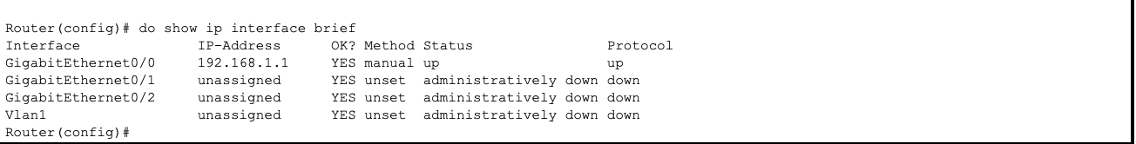
Router Configuration
Interface Setup
interface GigabitEthernet0/0
ip address 192.168.1.1
255.255.255.0
no shutdown
exit
Verify
[ Insert Screenshot ]
do show ip interface brief
Gi0/0 192.168.1.1
YES manual up up
show ip interface brief — Gi0/0 up/up

Slide 6
DHCP Configuration
DHCP Pool — LAN_POOL
DHCP Pool Summary
Exclude static addresses
ip dhcp excluded-address
Pool Name
LAN_POOL
192.168.1.1 192.168.1.10
Network
192.168.1.0 / 255.255.255.0
Create pool
ip dhcp pool LAN_POOL
network 192.168.1.0
Excluded
192.168.1.1 – 192.168.1.10
255.255.255.0
default-router 192.168.1.1
Assignable Range
192.168.1.11 – 192.168.1.254
dns-server 8.8.8.8
exit
Default Gateway
192.168.1.1
write memory
DNS Server
8.8.8.8

Slide 7
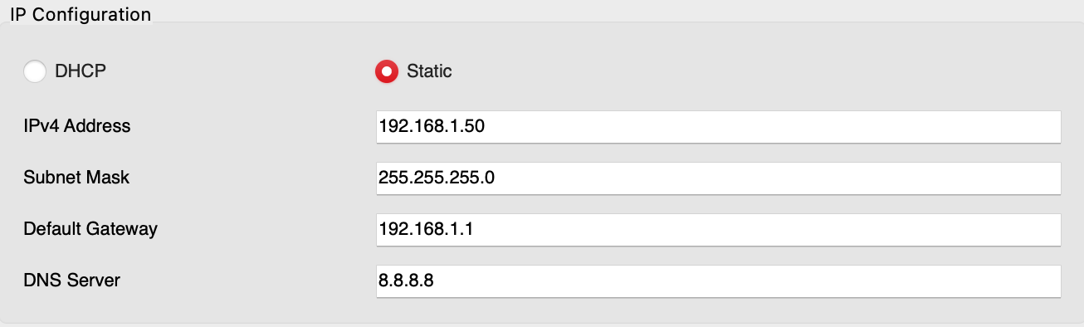
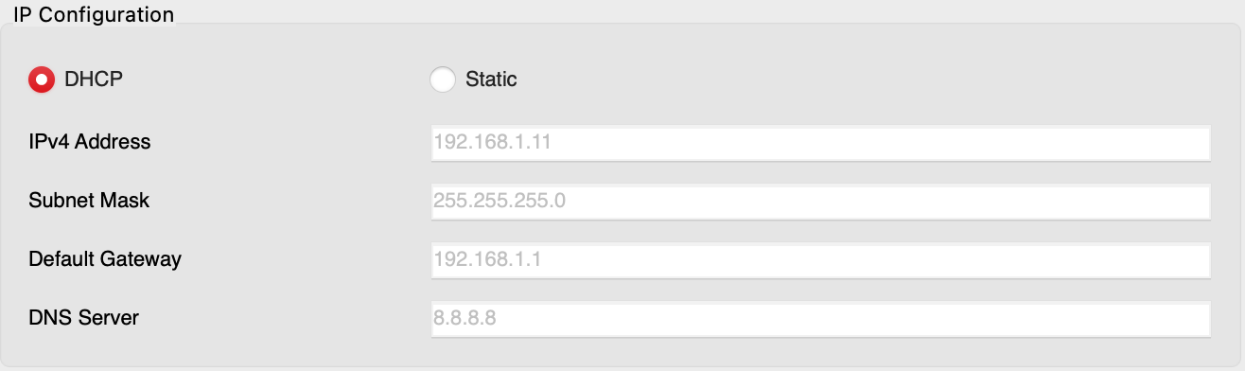
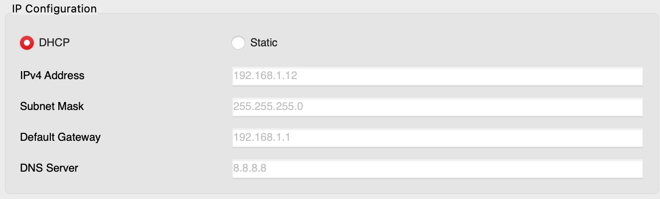
PC IP Configuration
PC0 — Static IP (192.168.1.50)
PC1 — DHCP (192.168.1.11)
PC2 — DHCP (192.168.1.12)
[ Insert Screenshot ]
[ Insert Screenshot ]
[ Insert Screenshot ]
PC0 — ipconfig
PC1 — ipconfig
PC2 — ipconfig

Slide 8
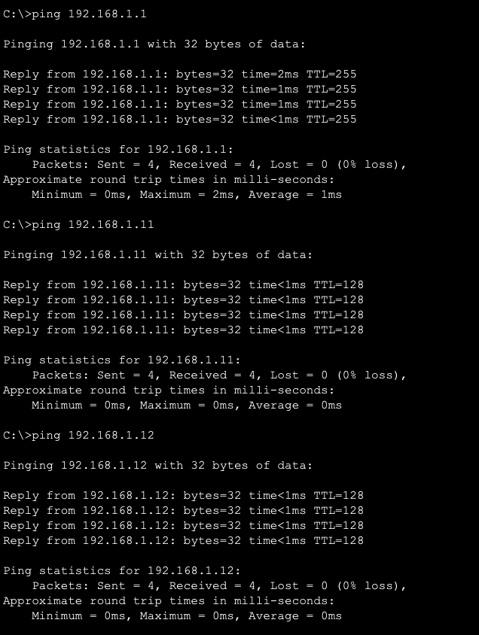
Ping Testing
✓ All Pings Successful
All Pings Successful
PC0 → Router0
Success
ping 192.168.1.1
PC0 → PC1
Success
[ Insert Screenshot ]
ping 192.168.1.11
PC0 → PC2
Success
ping 192.168.1.12
PC0 Command Prompt — Ping Results

Slide 9
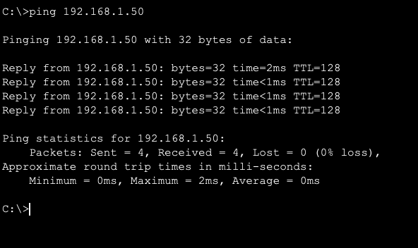
Ping Verification — PC1
✓ Bidirectional Communication Confirmed
Bidirectional Communication Confirmed
[ Insert Screenshot ]
PC1 — Ping to PC0 (192.168.1.50)

Slide 10
Complete Testing Summary
All Tests Successful
PC0 → Router0
PC0 → PC2
✓ Success
✓ Success
Gateway
Cross-device
PC0 → PC1
PC1 → PC0 (Static)
✓ Success
✓ Success
Cross-device
Bidirectional

Slide 11
Lab 1 Successfully Completed
✓ Static and DHCP addressing configured successfully
✓ DHCP pool verified — addresses assigned to PC1 and PC2
✓ All ping tests passed — 4/4 replies, 0% packet loss
✓ All lab objectives achieved

